Slide 1
CROP RELATED PATTERN AND CROP DISEASE DETECTION USING DATA MINING AND DENSENET-121
GUIDE DETAILS:
DR. R. GEETHA RAMANI
PROFESSOR
DEPARTMENT OF IST
STUDENT DETAILS:
SAMUNDAR SINGH
2019272033
MCA(SS) 2019-22

Slide 2
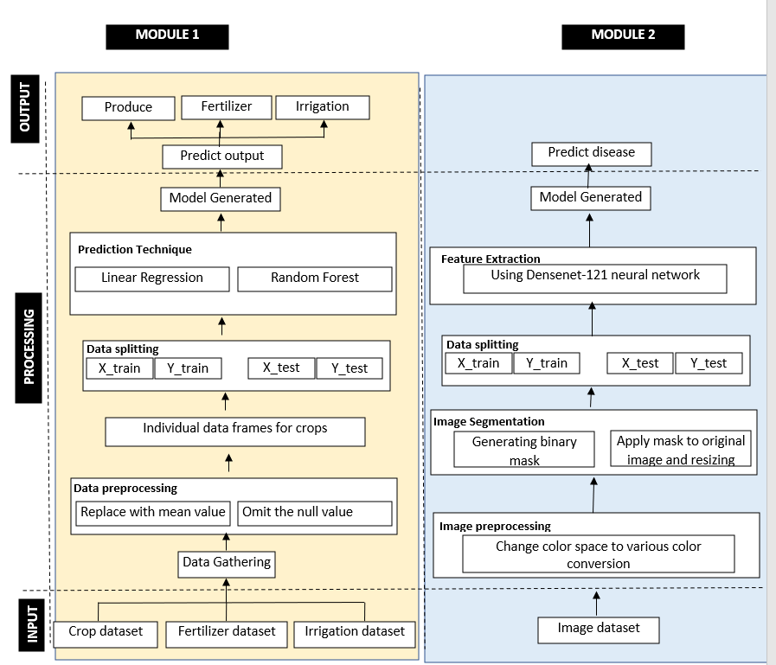
OVERALL ARCHITECTURE
First review
second review

Slide 3
LIST OF MODULES
Module 1
Sub-module 1
Description : Predicting the produce of crop
Total 23 model of different crops is created
The accuracy of different model vary from 75% -95%
Pre -processing
Input
Cleaning the dataset
Split the data frame on basis of crops
Output
Crop produce dataset
Total 23 model of different crop created
Split the dataset on train and testing data frame
Using linear regression Train the model and dumped it

Slide 4
LIST OF MODULES
Module 1
Sub-module 2
Description : Predicting the Irrigation
Total 20 model of different crops is created
The accuracy of different model vary from 65% -89%
Pre -processing
Input
Cleaning the dataset
Split the data frame on basis of crops
Output
Crop irrigation dataset
Total 20 model of different crop created
Split the dataset on train and testing data frame
Using random forest Train the model and dumped it

Slide 5
LIST OF MODULES
Module 1
Sub-module 3
Description : Predicting the fertilizers.
Total 3 model of nitrogen, phosphate and potash are created
The accuracy of different model vary from 71% -80%
Pre -processing
Input
Cleaning the dataset
Split the data frame on basis of crops
Output
Crop fertilizer dataset
Total 3 models of fertilizer is created
Split the dataset on train and testing data frame
Using random forest Train the model and dumped it

Slide 6
LIST OF MODULES
Module 2
Description : Predicting the disease of the plant.
Total 14 different crop and 38 different disease are detected by this model
The accuracy of different model vary from 93%.
Processing
Changing the Color Space (RGB to HSV)
Generating Binary Mask
Input
Output
Applying mask to original image
Plant Disease images
Total 3 models of fertilizer is created
Split the data to train and testing frame
Split the data to train and testing frame
Using the Densenet -121
Model Created

Slide 7
Module-1 (1)
ALGORITHM TO FIND THE CROP PRODUCE USING LINEAR REGRESSION
1: Start
2: import linear regression from sklearn
3: take variable lr = Linear Regression(normalize=True)
4: get the X train = train df(area)
5: Get the Y train = train df(produce)
6: Get the x test = test df. drop (produce, axis=1). copy()
7: fit in variable lr.fit (x train, Y train)
8: lr. predict = lr. predict (X test)
9: lr. accuracy = round (lr. score(X train,Y train) * 100,2)
10: print lr. accuracy

Slide 8
Module-1 (2)
ALGORITHM TO FIND THE IRRIGATION AND FERTILIZER VALUE
1: Start
2: import RandomForestRegressor from sklearn.
3: take variable tree1,tree2 = RandomForestRegressor
4: split the irrigation dataframe according to the crop.
5: split the fertilizer dataframe according to the district.
6: get the x1train = train df (district name)
7: get the x2train = train df (district)
8: Get the y1 train = train df(fertilizer names)
9: Get the y2train = train df(crop irrigation data )
10: create the test data for both the data frame also using train_test_split feature
11: fit in variable tree1.fit(x1train, y1train)
12: fit in variable tree2.fit(x2train, y2train)
13: output1 = tree1.predict(x1 test)
14: output2 = tree2.predict(x2.test)
15: outpu1.accuracy = print round(tree1.score(X train,Y train) * 100,2)
16: outpu2.accuracy = print round(tree2.score(X train,Y train) * 100,2)

Slide 9
Module-2
ALGORITHM TO FIND DISEASE OF PLANT USING DENSENET-121
1: start
2: image Acquisition.
3: Convert the RGB to HSV, lab colour and greyscale format.
4: Generate Binary Mask after filling gaps.
5: Apply mask to the original image and Resizing it.
6: import Densenet 121 from keras.application .
7: get xtrain = np.zeros((train.shape[0], IMAGE_SIZE, IMAGE_SIZE, 3))
8: Normalise the data by dividing it 255.
9: get ytrain=train['Disease ID'].values.
10: ytrain = to_categorical(y_train, num_classes=15).
11: xtest=pick an image and normalize it and feed to model.
12: use IimageDataGenerator and fit the imane into it.
13: get Accuracy by model.fit_generator function

Slide 10
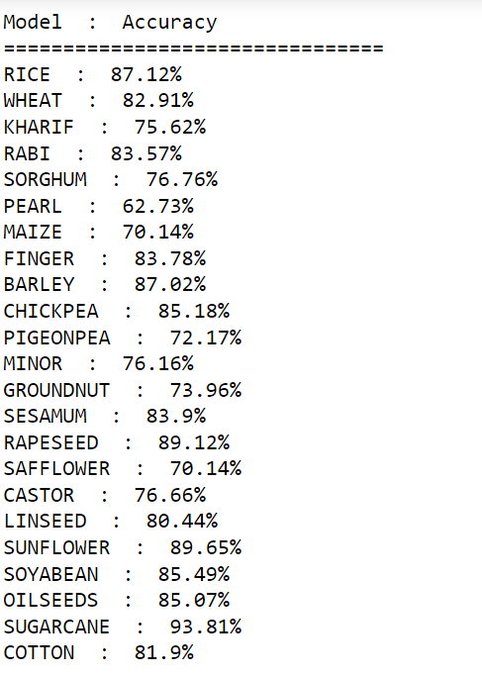
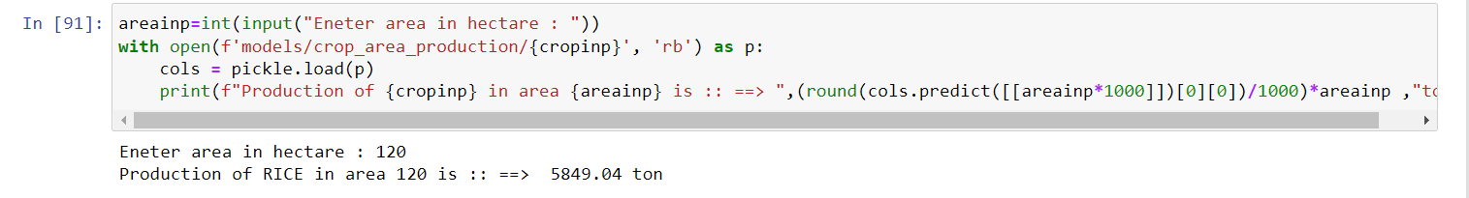
Module-1 (1)
Crop-Area-produce Model:
Example

Slide 11
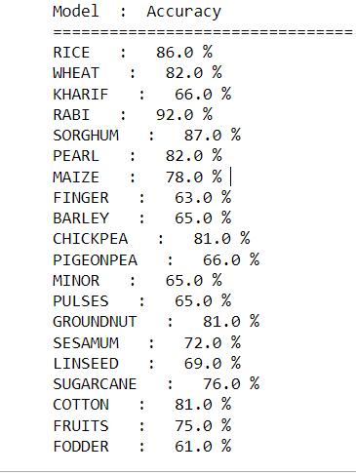
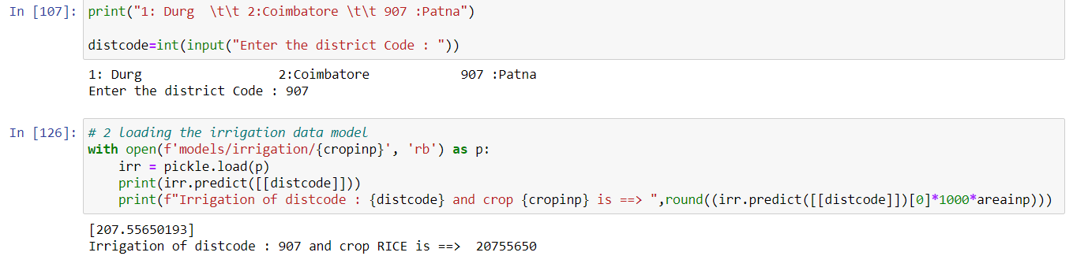
Module-1 (2)
Crop-Irrigation Model:
Example

Slide 12
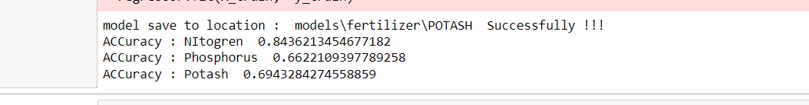
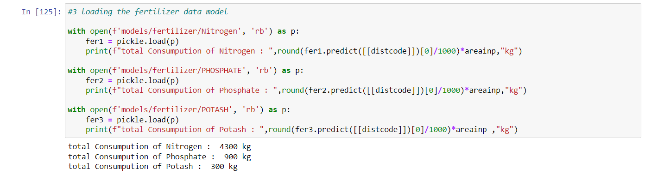
Module-1 (3)
Crop-Fertilizer Model:
Example

Slide 13
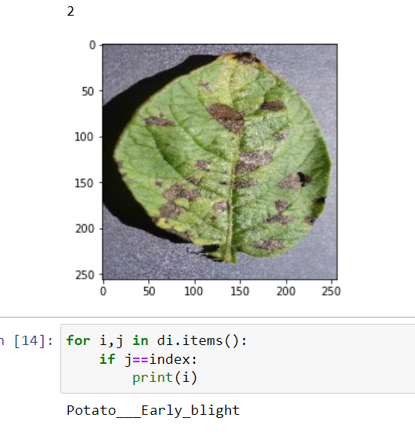
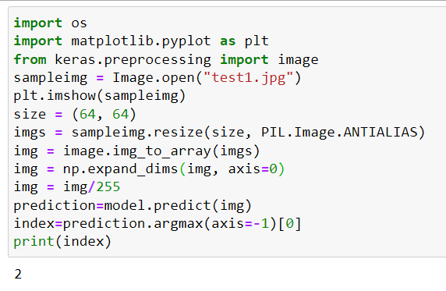
Module-2
Crop-Disease Model:

Slide 14
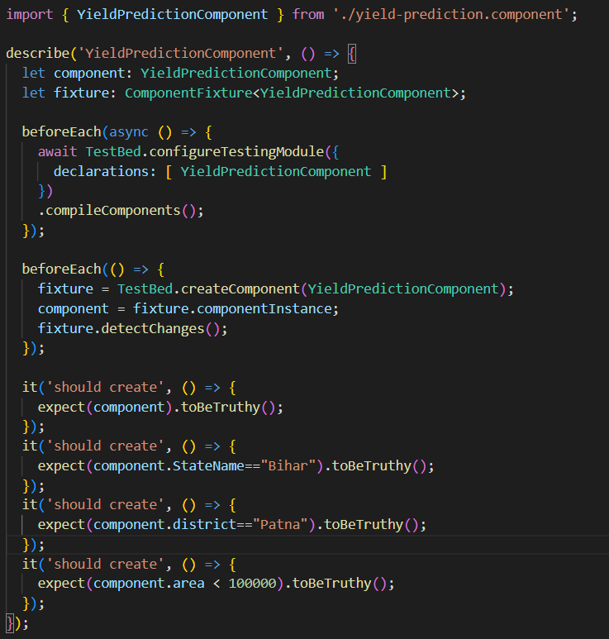
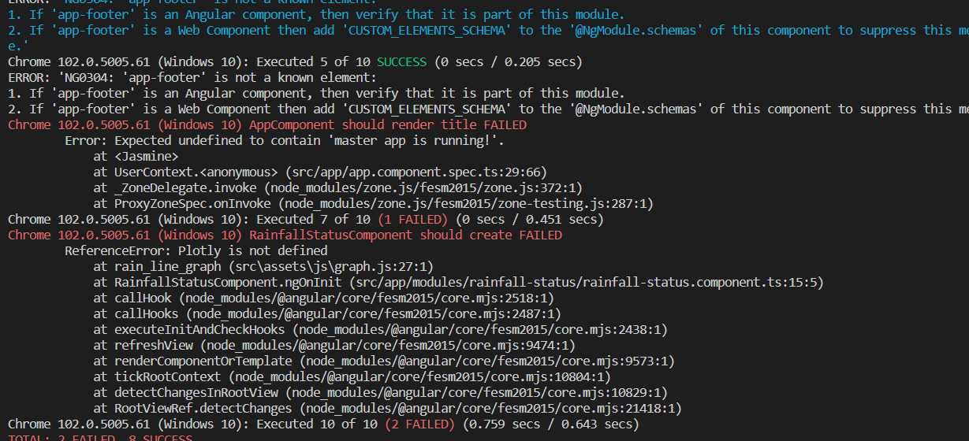
Unit test case for Crop Produce
Result

Slide 15
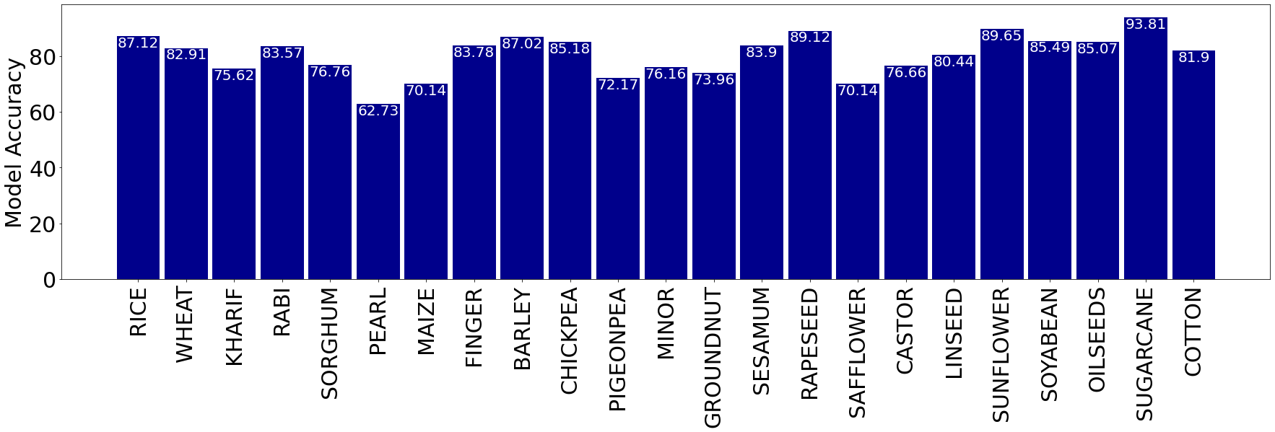
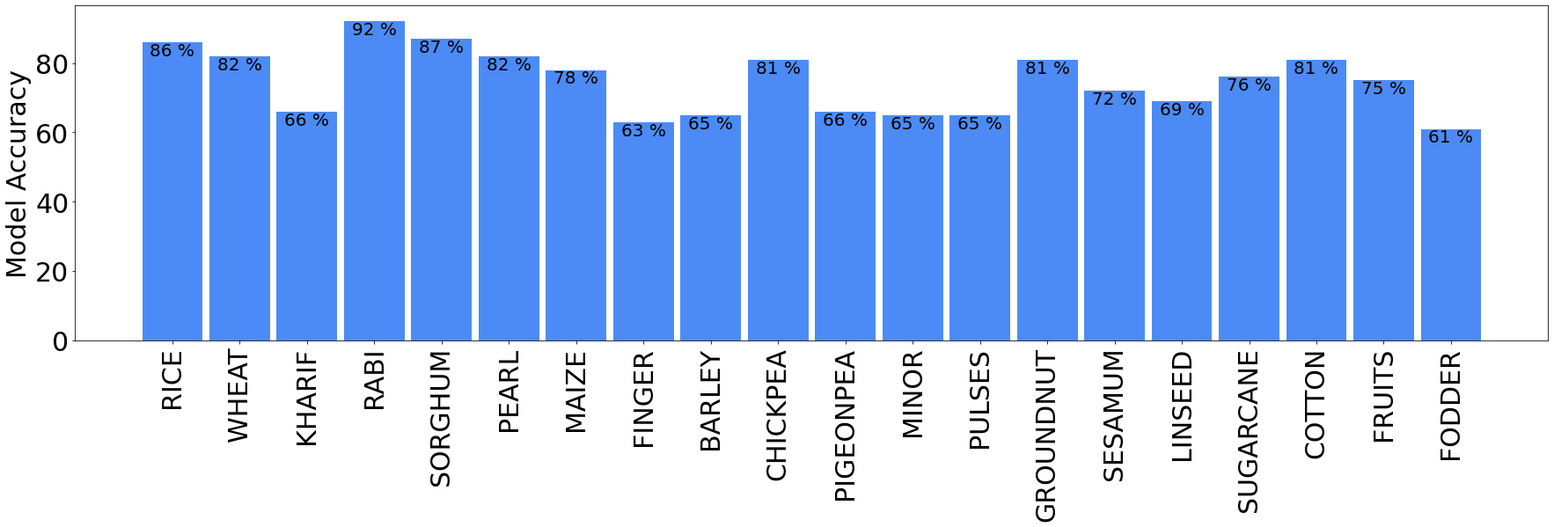
Graphical Analysis (1)
Accuracy Graph of Crop-Produce model.
Accuracy Graph of Irrigation model.

Slide 16
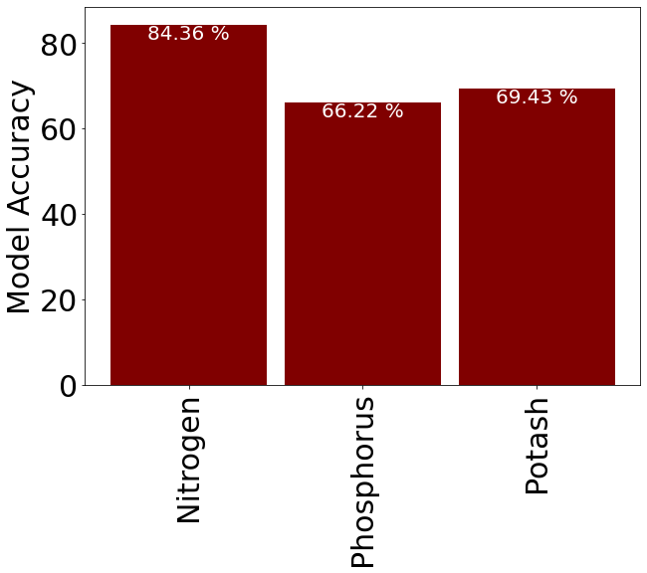
Graphical Analysis (2)
Accuracy Graph of Fertilizer model.

Slide 17
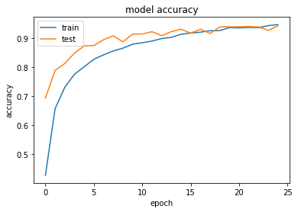
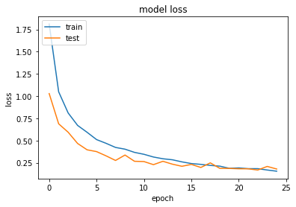
Graphical Analysis (3)
Accuracy and loss Graph of Plant Disease model.

Slide 18
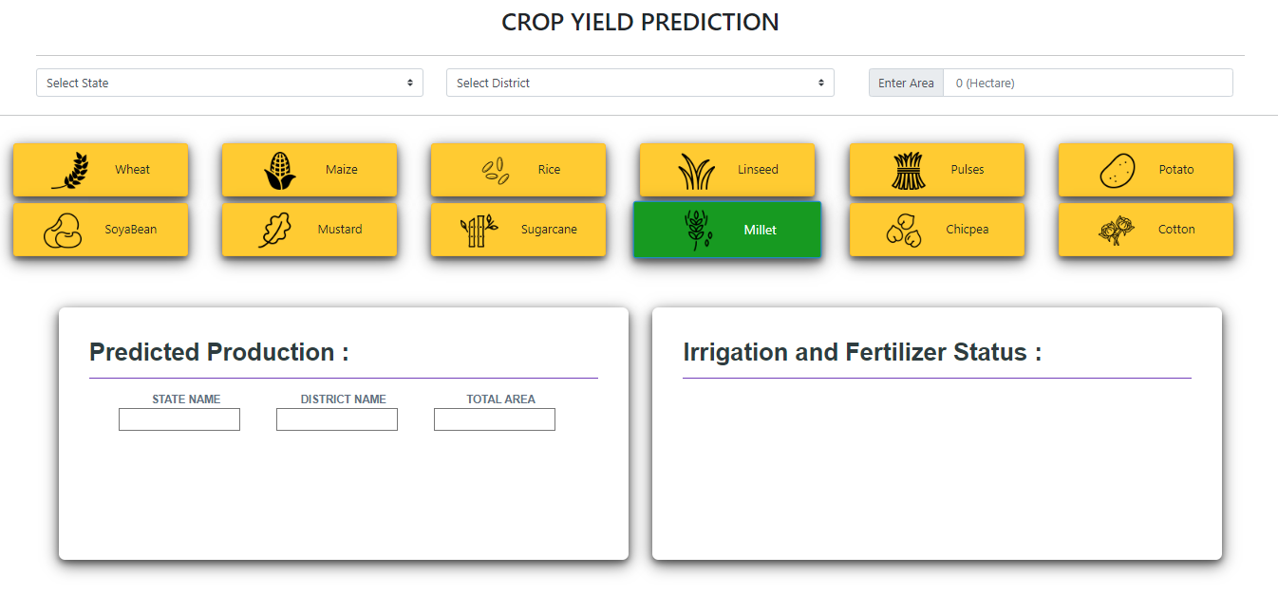
User Interface -1

Slide 19
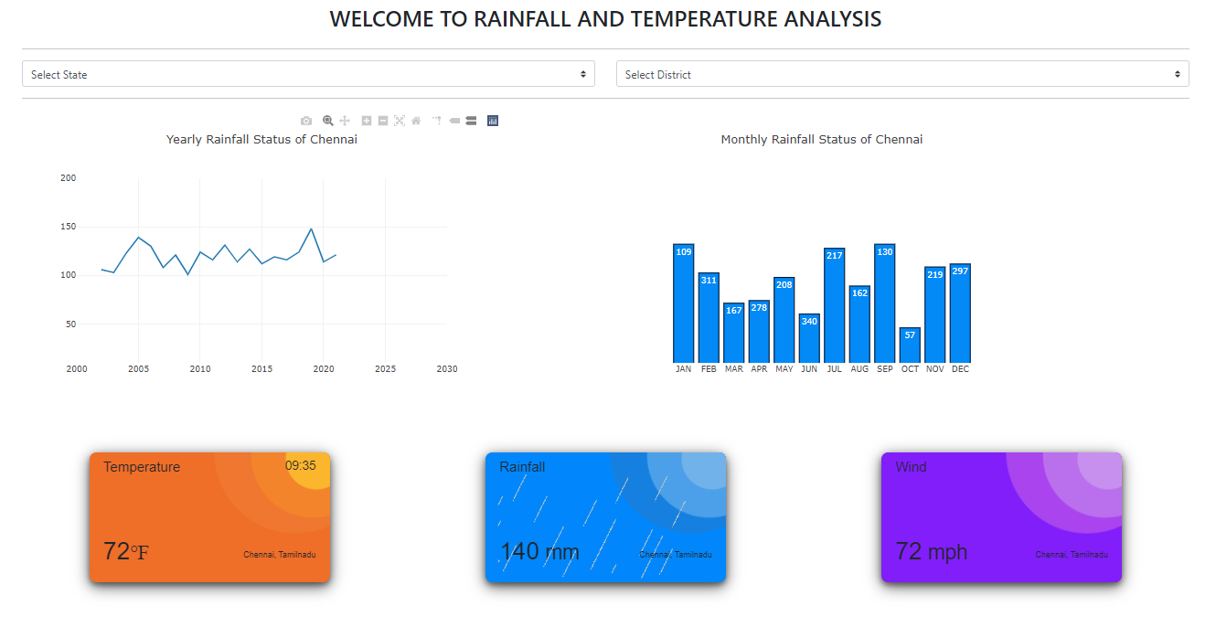
User Interface -2

Slide 20
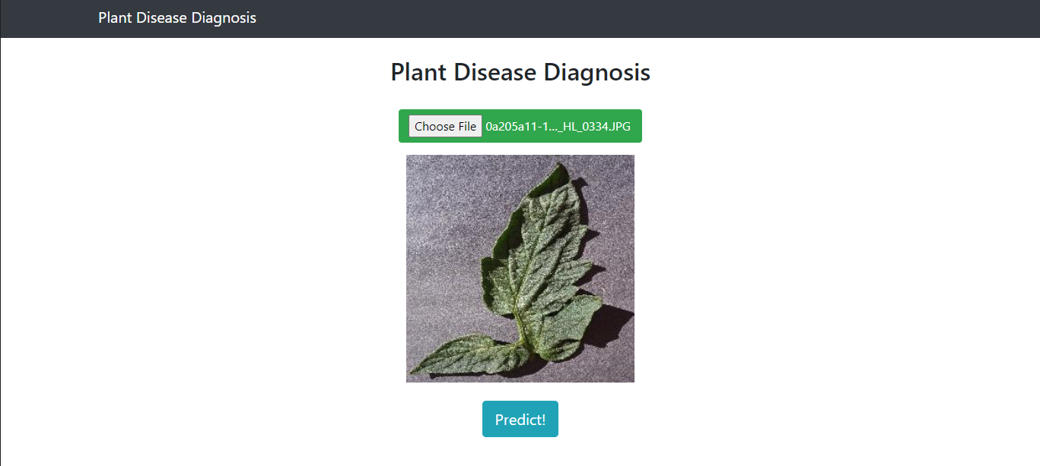
User Interface -3

Slide 21
Thank You

